Slide 1
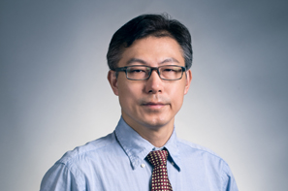
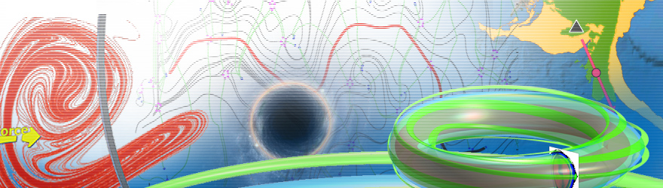
生物动力系统模拟
王冠宇 18665955633
wanggy@sustc.edu.cn

Slide 2
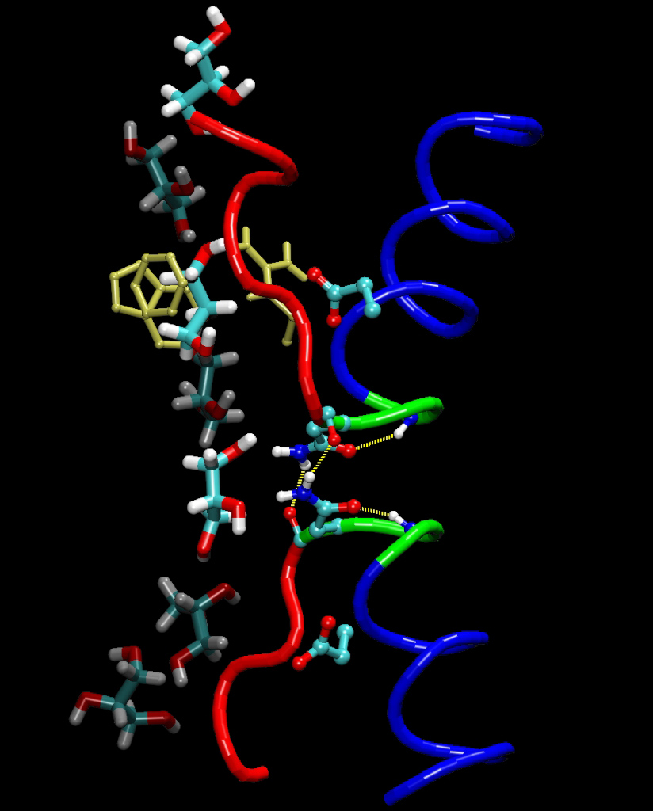
Molecular Dynamics Simulation

Slide 3
Contents:
Periodic Boundary Condition (PBC)
Steps of simulation
Middle term exam problems

Slide 4
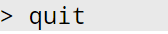
6. To quit xLEaP use quit.
All the above steps are just for preparation
Now let’s get into the real meat.
Minimization
2. Heating with constant volume and temperature (NVT) for 20ps from 0K to 300K
3. Production MD with constant pressure and temperature (NPT) at 300K and 1atm for 60ps

Slide 5
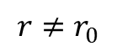
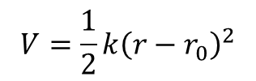
Minimization
Why minimization?
An initial structure is likely to be NOT in its most natural structure
This can be easily seen from the simplest structure: a bond
r
$$V=\frac{1}{2}k{\left(r−r_{0}\right)}^{2}$$
if other forces are ignored
As long as
$$r≠r_{0}$$
, it is not natural
Therefore, the natural state corresponds to V = 0, energy minimal.
To begin MD with the most natural structure, one must perform minimization.

Slide 6
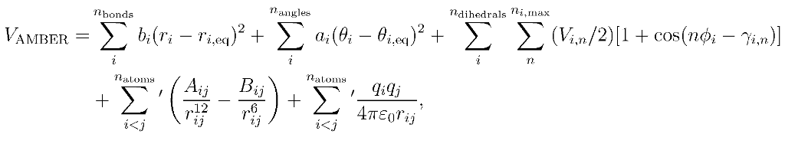
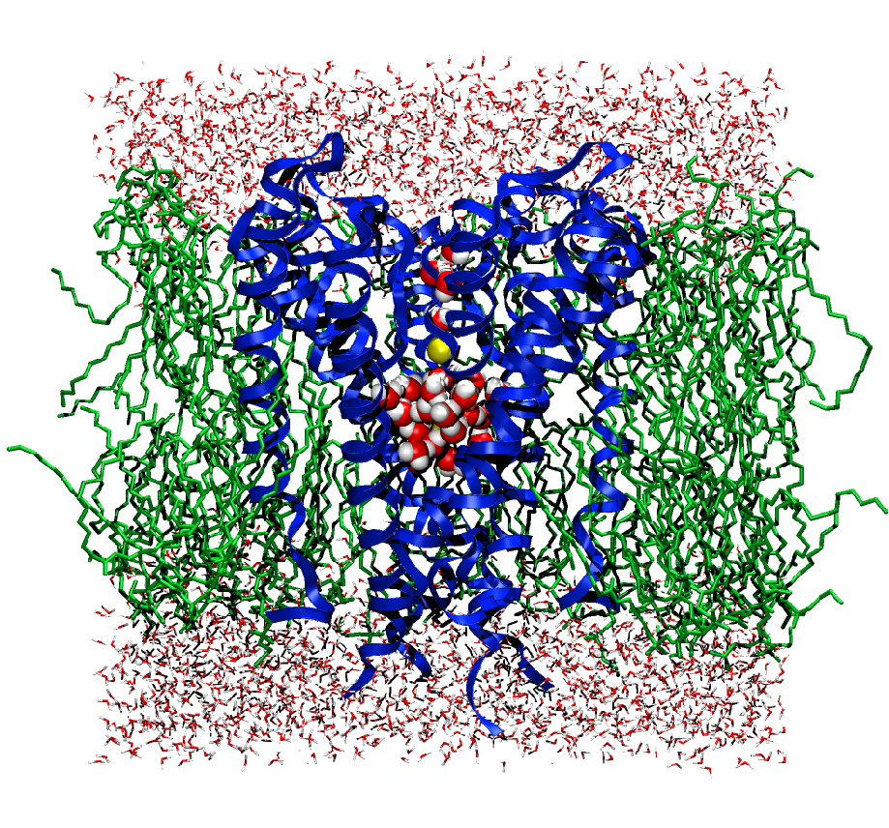
But the real scenario is not that simple
1. The terms are coupled, reduce one would increase another
2. The equation is too complex to minimize analytically
3. Numerical minimization is required.

Slide 7
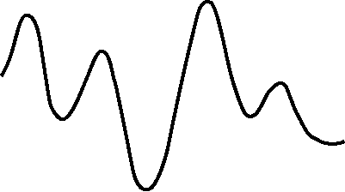
Numerical methods for minimization
Energy
The energy of the system can be calculated using the forcefield. The conformation of the system can be altered to find lower energy conformations through a process called minimization.
Conformational change
Minimization algorithms:
steepest descent (slowly converging – use for highly restrained systems
conjugate gradient (efficient, uses intelligent choices of search direction – use for large systems)
BFGS (quasi-newton variable metric method)
Newton-Raphson (calculates both slope of energy and rate of change)

Slide 8
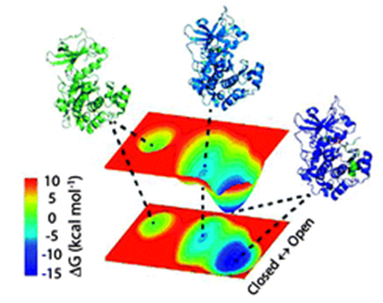
The above algorithms are deterministic, usually only lead to local minimums.
Energy
Conformational change
Stochastic algorithms can also be used to continue the minimization.
But this is usually not practiced.

Slide 9
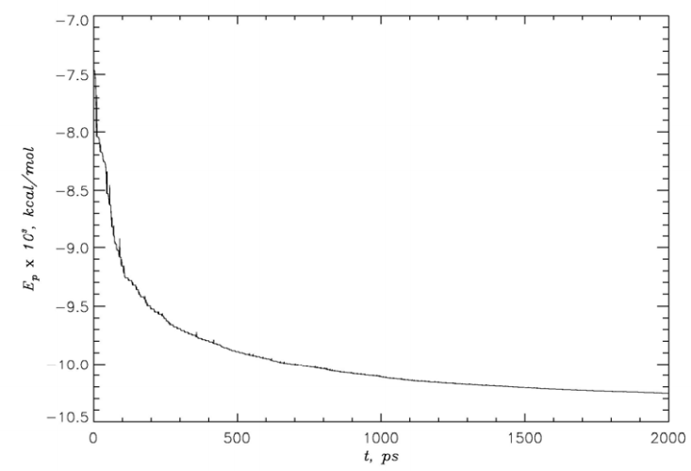
An example of energy minimization

Slide 10
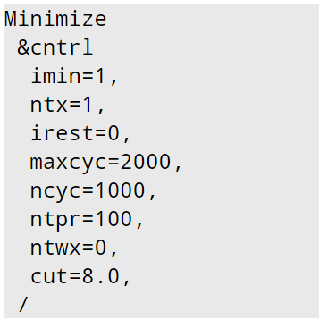
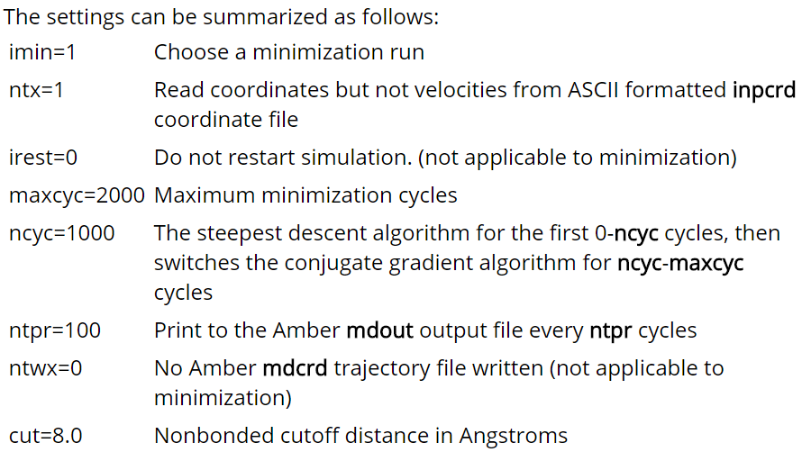
7. Create the file 01_Min.in that includes the following settings for minimization:

Slide 11
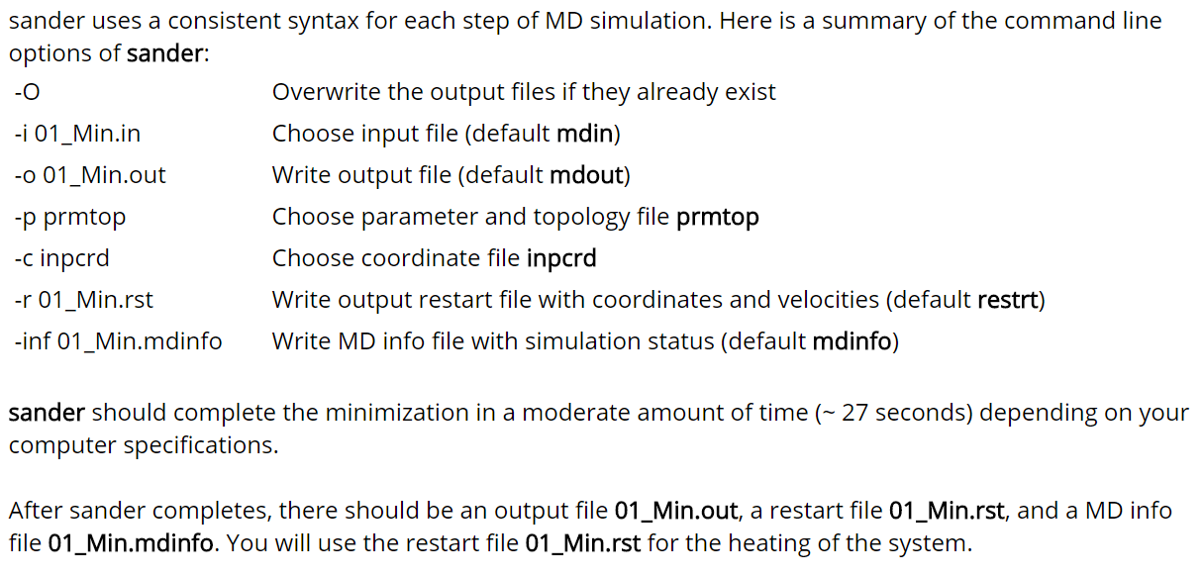
8. Run the minimization of alanine dipeptide with sander.

Slide 12

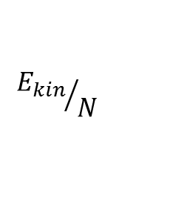
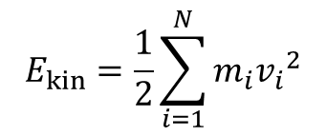
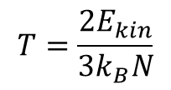
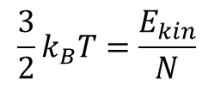
Heating
Temperature
It measures kinetic energies of individual atoms.
It is actually averaged kinetic energy.
1. First we calculate the total kinetic energy
$$E_{kin}=\frac{1}{2}\sum_{i=1}^{N}{m_{i}{v_{i}}^{2}}$$
2. Then we divide N to get the average kinetic energy
$${E_{kin}}/N$$
almost
3. It is the temperature T
$$\frac{3}{2}k_{B}T=\frac{E_{kin}}{N}$$
$$T=\frac{{2E}_{kin}}{3k_{B}N}$$

Slide 13
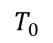
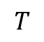
Heating
300 K
0 K
Let the temperature T gradually increase from to .
310 K
Initial crystal structure is static, which corresponds to 0K
Many target temperatures
0 50 K 100K 150 K … 300 K
$$T$$
$$T_{0}$$
How does the algorithm achieves the increase from T to T₀ ?

Slide 14
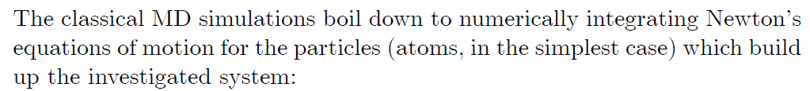
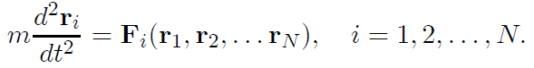
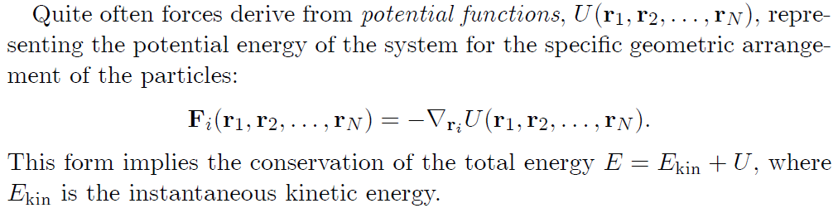
Basic Computation

Slide 15
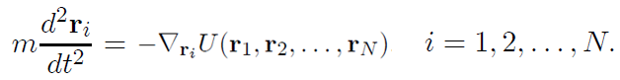
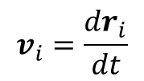
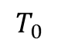
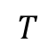
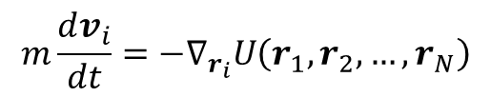
Therefore we have
Because it is temperature to be discussed, we use velocity for further discussion
$$v_{i}=\frac{dr_{i}}{dt}$$
$$m\frac{dv_{i}}{dt}=−∇_{r_{i}}U\left(r_{1},r_{2},…,r_{N}\right)$$
Once initial positions and velocities given, the evolution of them are determined.
But we have to control it --- Increase the velocity so that T can rise to T₀
$$T$$
$$T_{0}$$

Slide 16
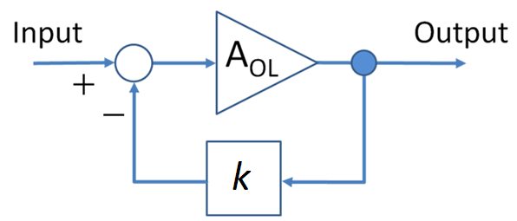
Negative feedback
(to achieve self-limiting)
The most fundamental regulatory mechanism
Widely used by nature and in the engineering systems
A
B

Slide 17
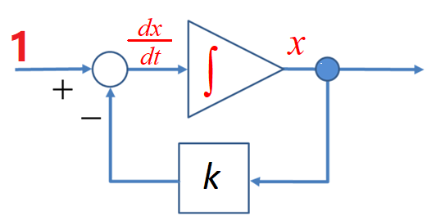
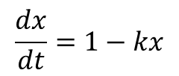
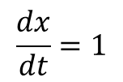
Without feedback
x
$$\frac{dx}{dt}=1$$
t
With feedback
x
$$\frac{dx}{dt}=1−kx$$
t

Slide 18
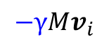
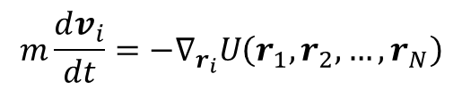
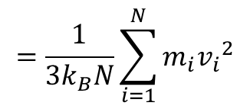
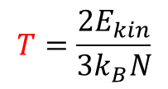
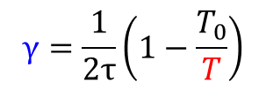
$$m\frac{dv_{i}}{dt}=−∇_{r_{i}}U\left(r_{1},r_{2},…,r_{N}\right)$$
$$−γMv_{i}$$
$$γ=\frac{1}{2τ}\left(1−\frac{T_{0}}{T}\right)$$
$$T=\frac{{2E}_{kin}}{3k_{B}N}$$
$$=\frac{1}{3k_{B}N}\sum_{i=1}^{N}{m_{i}{v_{i}}^{2}}$$

Slide 19
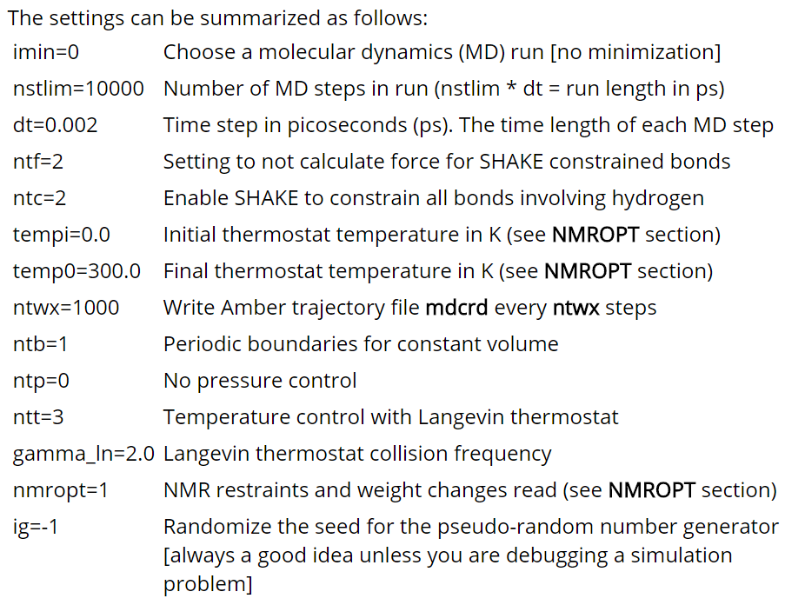
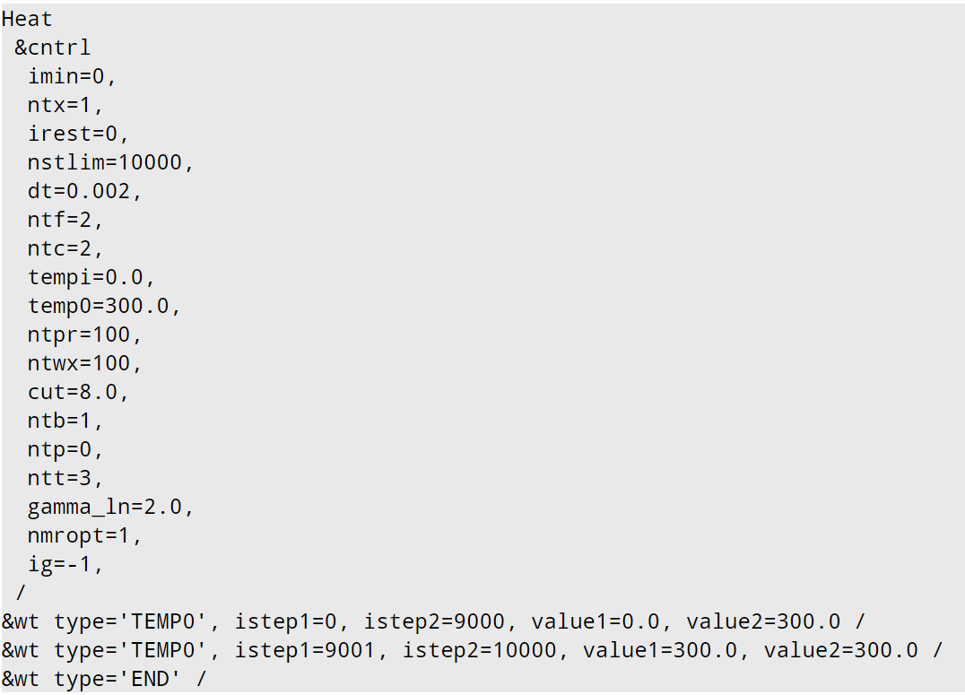
9. Create the file 02_Heat.in that includes the following settings for heating:

Slide 20
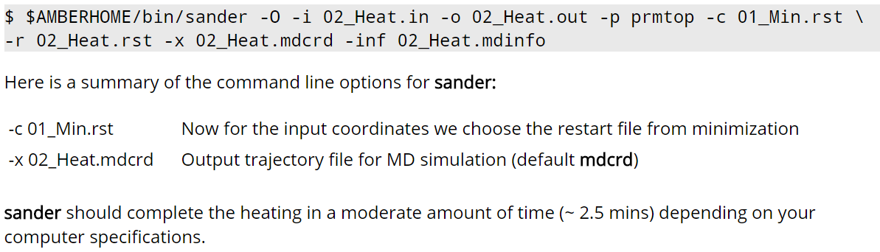
10. Run the heating of alanine dipeptide with sander

Slide 21
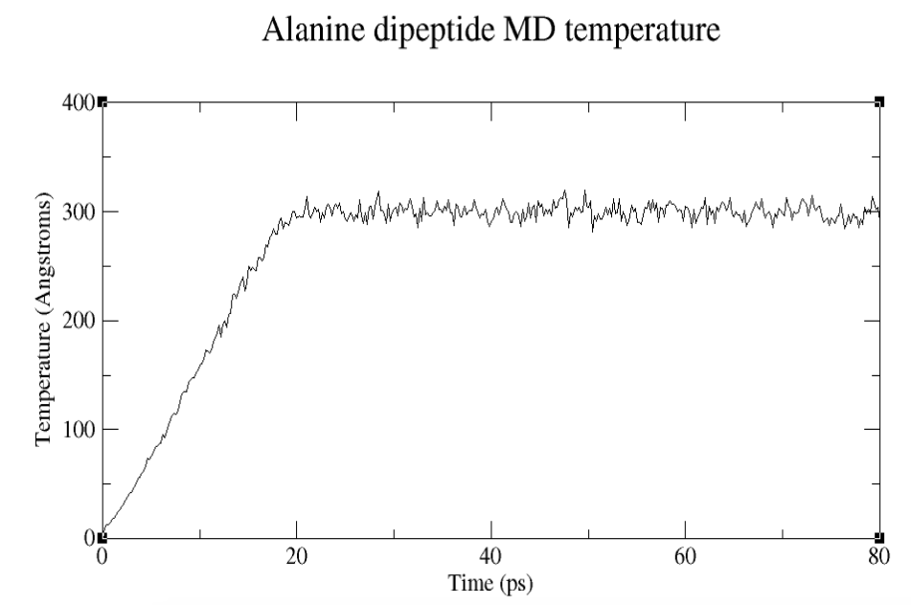

Slide 22
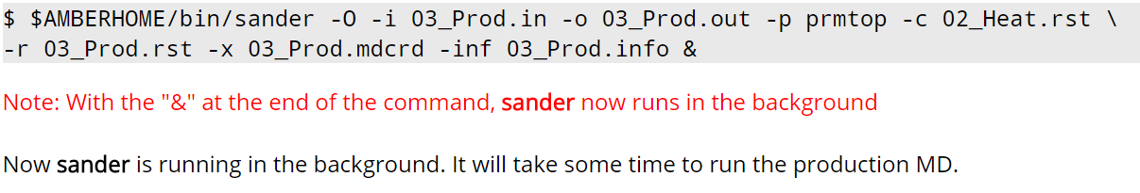
Run production MD
11. Now that minimization and heating are complete.
We move on to the actual production MD.

Slide 23
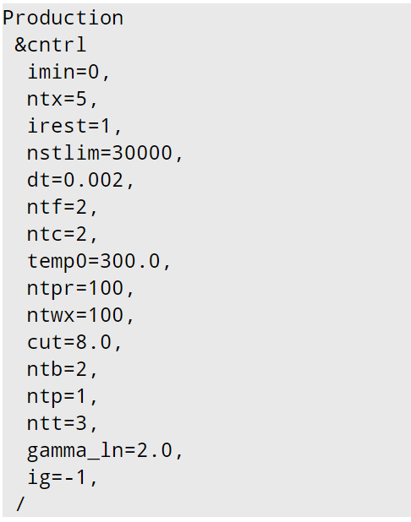
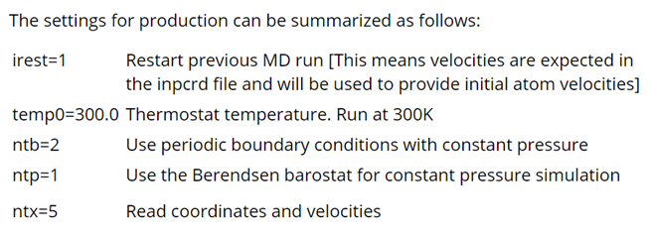
12. Create the file 03_Prod.in with the settings for production MD
from which file?

Slide 24
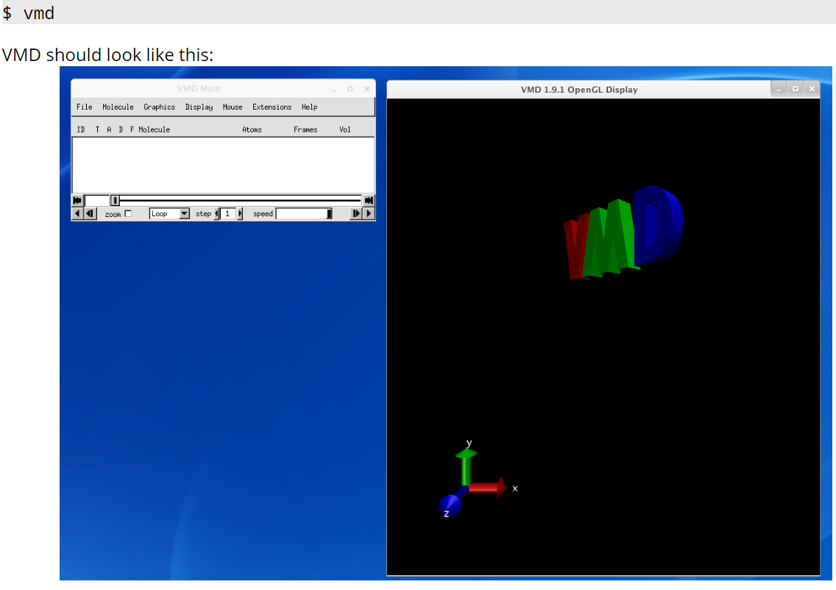
Visualize the results
You've now run an MD simulation. In order to visualize the results, we will now use a program called VMD (Visual Molecular Dynamics). This is a molecular graphics program that can render molecular structures in 3D. VMD not only loads Protein Database (PDB) structure files, but also MD trajectories from many programs.

Slide 25
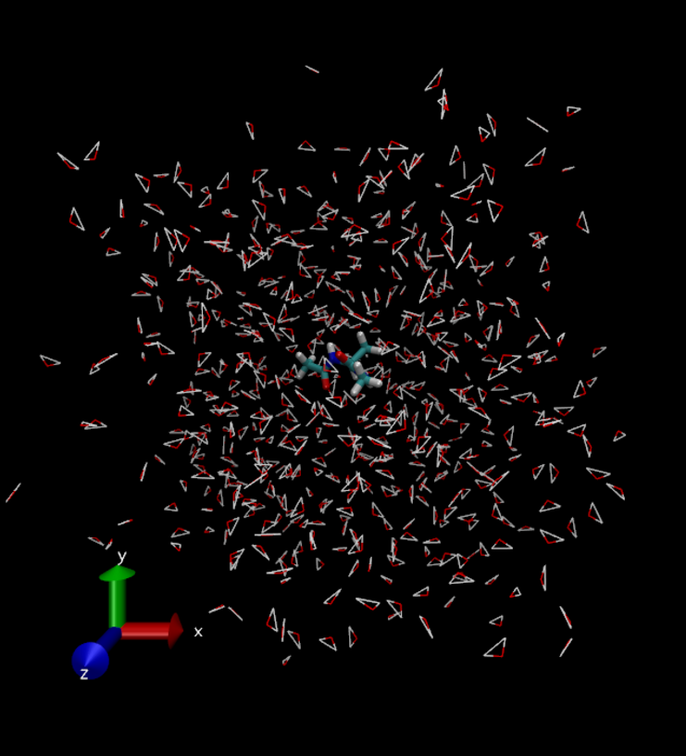
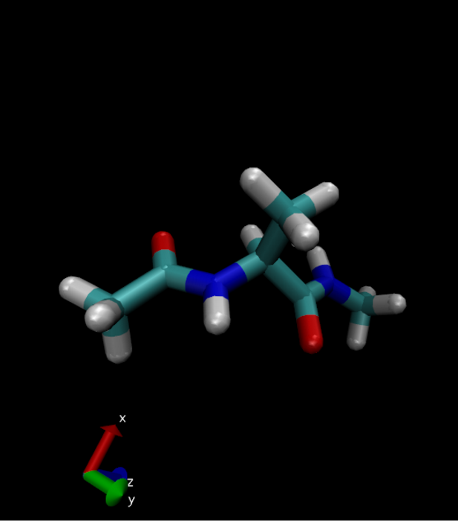

Slide 26
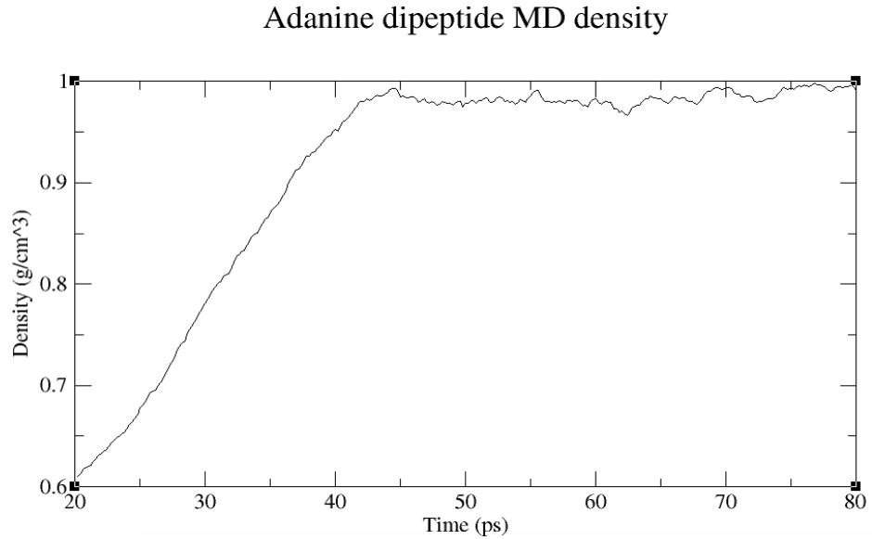
A
What happened? Why density increases?
B
This implies the volume of Box reduces!
This in turn implies that after heating,
The pressure is still smaller than that set
for the production phase.
So the box shrinks so that the pressure increases
to the preset one.

Slide 27
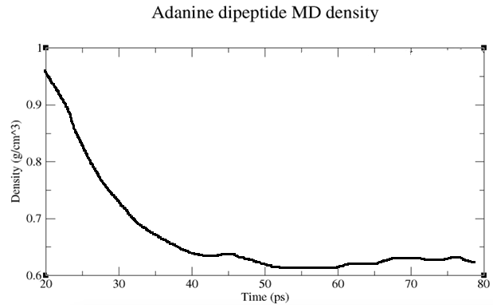
Can this happen? Density decreases?
This implies the volume of Box
increases
This in turn implies that after heating,
The pressure is than that set
for the production phase.
larger
So the box so that the pressure
to the preset one.
expands
reduces

Slide 28
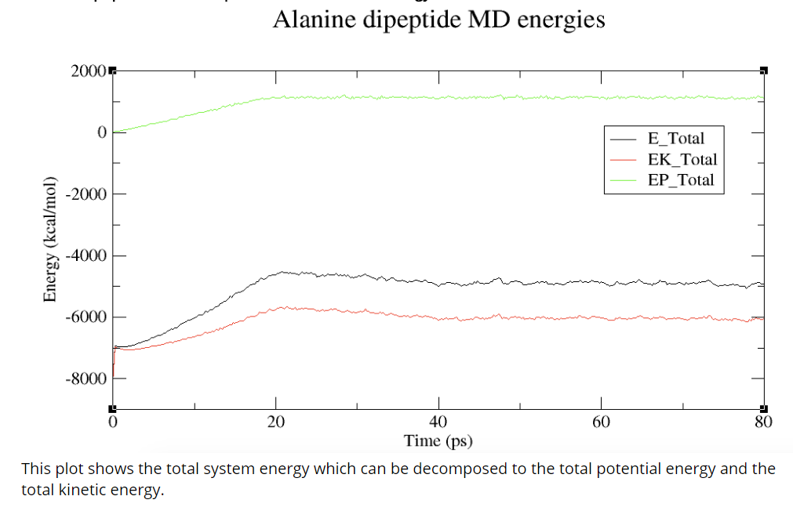

Slide 29


Slide 30



RMSD: Root-mean-square deviation of atomic positions

Slide 31
Since the next example is a larger protein, we introduce
How to get protein structure
PDB files.

